Slide 1
Section : Numerical Aptitude Topic : Number system Sub topic : Remainder Properties
Basic Properties in Remainder based problems with examples
Negative Remainder based problems.
Cyclicity based Remainder problems.
Theorem based Remainder problems.
Note: Remainder should always be less than your divisor.

Slide 2
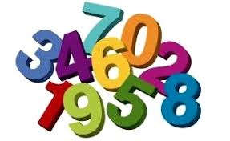
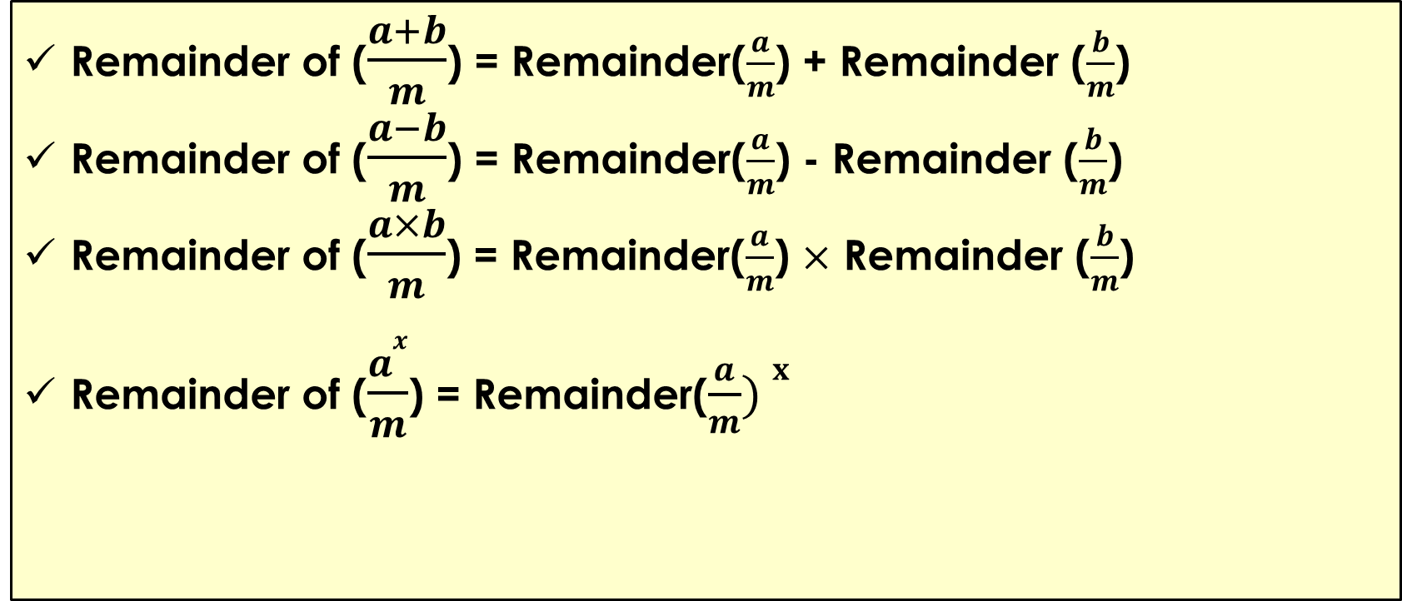
Remainder Properties
Remainder of ($\frac{a+b}{m}$) = Remainder($\frac{a}{m}$) + Remainder ($\frac{b}{m}$)
Remainder of ($\frac{a−b}{m}$) = Remainder($\frac{a}{m}$) - Remainder ($\frac{b}{m}$)
Remainder of ($\frac{a×b}{m}$) = Remainder($\frac{a}{m}$) $×$ Remainder ($\frac{b}{m}$)
Remainder of ($\frac{ax}{m}$) = Remainder($\frac{a}{m}) x$

Slide 3
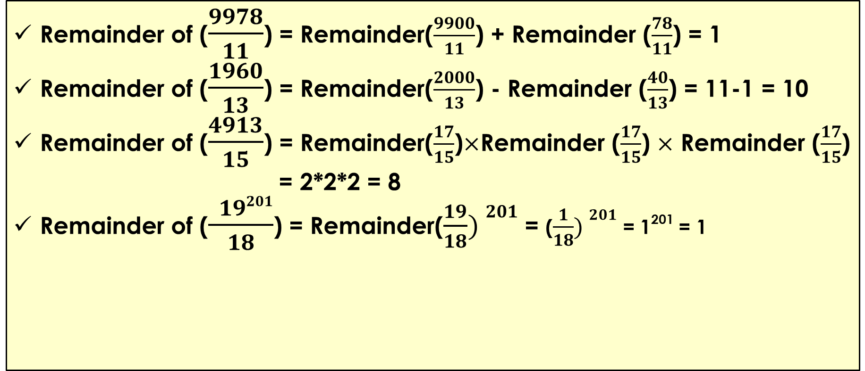
Remainder Properties
Remainder of ($\frac{9978}{11}$) = Remainder($\frac{9900}{11}$) + Remainder ($\frac{78}{11}$) = 1
Remainder of ($\frac{1960}{13}$) = Remainder($\frac{2000}{13}$) - Remainder ($\frac{40}{13}$) = 11-1 = 10
Remainder of ($\frac{4913}{15}$) = Remainder($\frac{17}{15}$)$×$Remainder ($\frac{17}{15}$) $×$ Remainder ($\frac{17}{15}$)
= 2*2*2 = 8
Remainder of ($\frac{ 19201}{18}$) = Remainder($\frac{19}{18}) 201$ = ($\frac{1}{18}) 201$ = 1²⁰¹ = 1

Slide 4
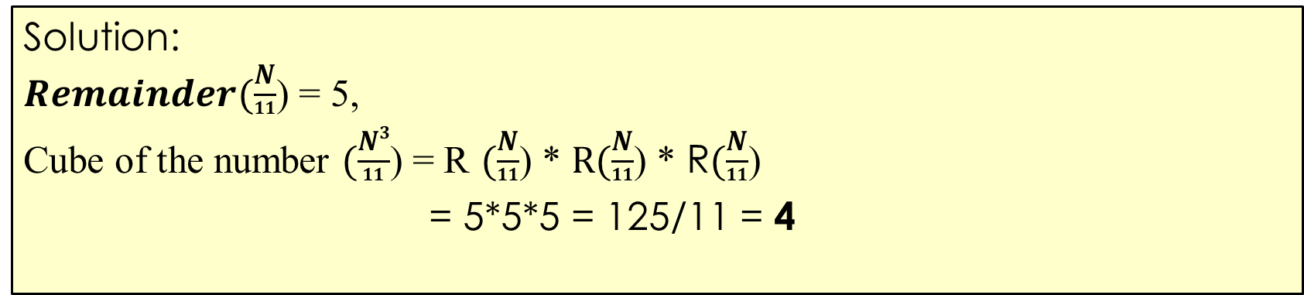
Remainder Properties
Example:
When a number ‘N’ is divided by 11 the remainder is 5 , when the cube of the number is divided by 11 what will be the remainder?
Solution:
$Remainder(\frac{N}{11}$) = 5,
Cube of the number $(\frac{N3}{11}$) = R $(\frac{N}{11}$) * $R(\frac{N}{11}$) * R$(\frac{N}{11}$)
= 5*5*5 = 125/11 = 4

Slide 5
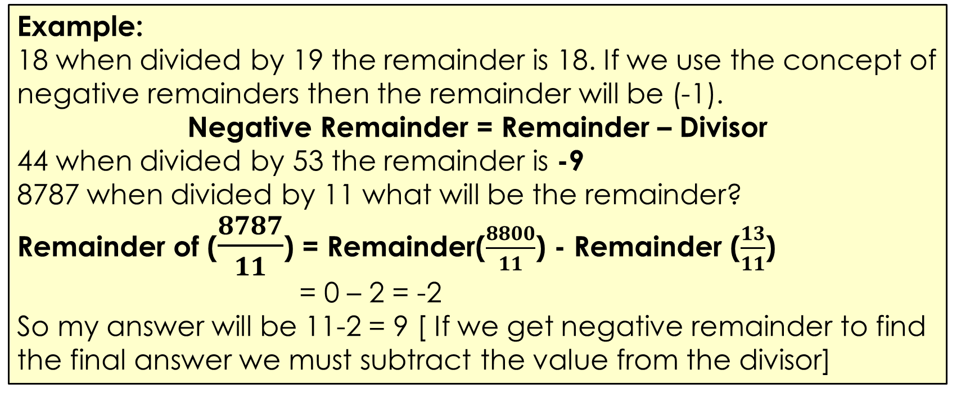
Remainder Properties
Concept of Negative Remainder:
Example:
18 when divided by 19 the remainder is 18. If we use the concept of negative remainders then the remainder will be (-1).
Negative Remainder = Remainder – Divisor
44 when divided by 53 the remainder is -9
8787 when divided by 11 what will be the remainder?
Remainder of ($\frac{8787}{11}$) = Remainder($\frac{8800}{11}$) - Remainder ($\frac{13}{11}$)
= 0 – 2 = -2
So my answer will be 11-2 = 9 [ If we get negative remainder to find the final answer we must subtract the value from the divisor]

Slide 6
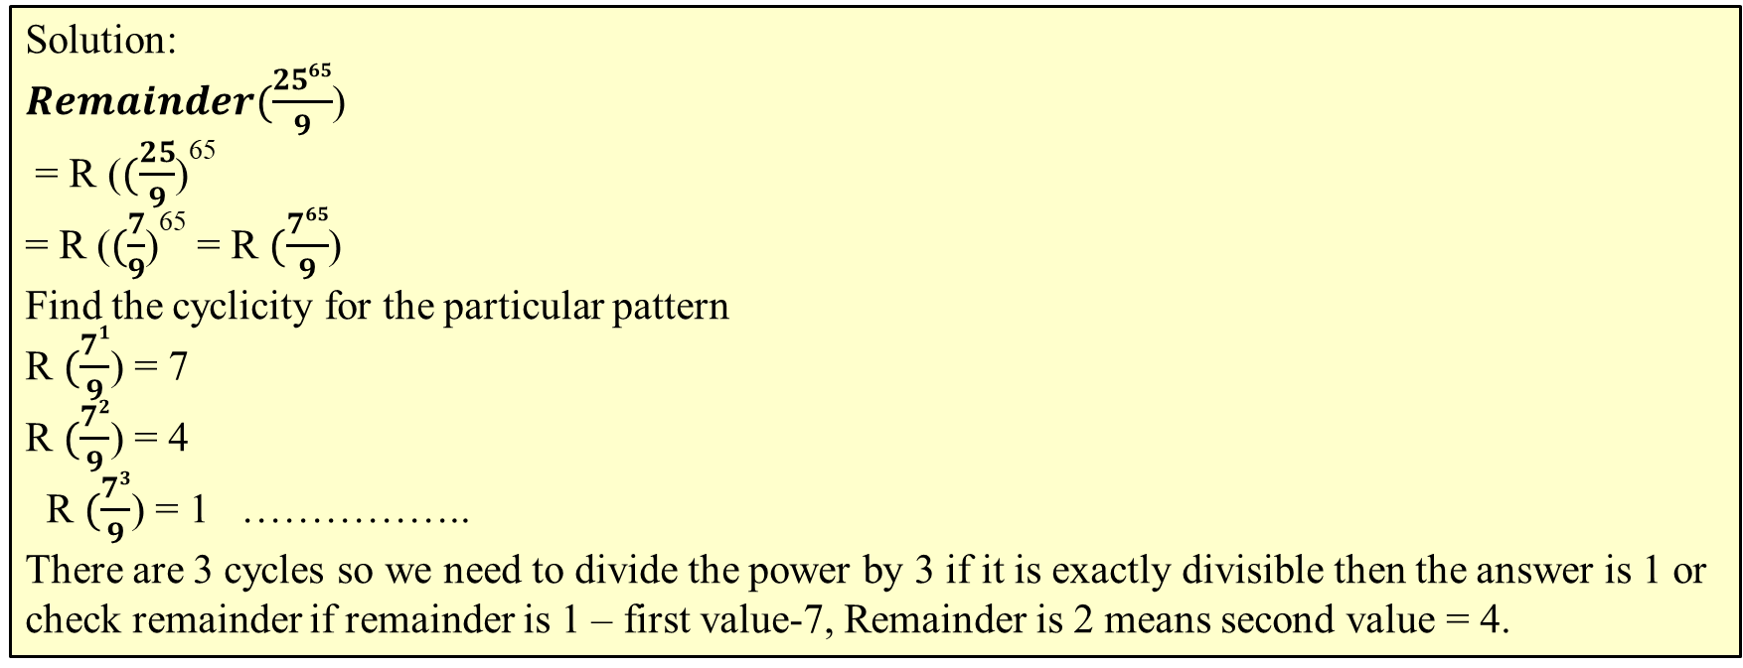
Remainder Properties
Examples: Find the remainder when 25^65 is divided by 9.
Solution:
$Remainder(\frac{2565}{9}$)
= R ($(\frac{25}{9}$)⁶⁵
= R ($(\frac{7}{9}$)⁶⁵ = R $(\frac{765}{9}$)
Find the cyclicity for the particular pattern
R $(\frac{71}{9}$) = 7
R $(\frac{72}{9}$) = 4
R $(\frac{73}{9}$) = 1 ……………..
There are 3 cycles so we need to divide the power by 3 if it is exactly divisible then the answer is 1 or check remainder if remainder is 1 – first value-7, Remainder is 2 means second value = 4.

Slide 7
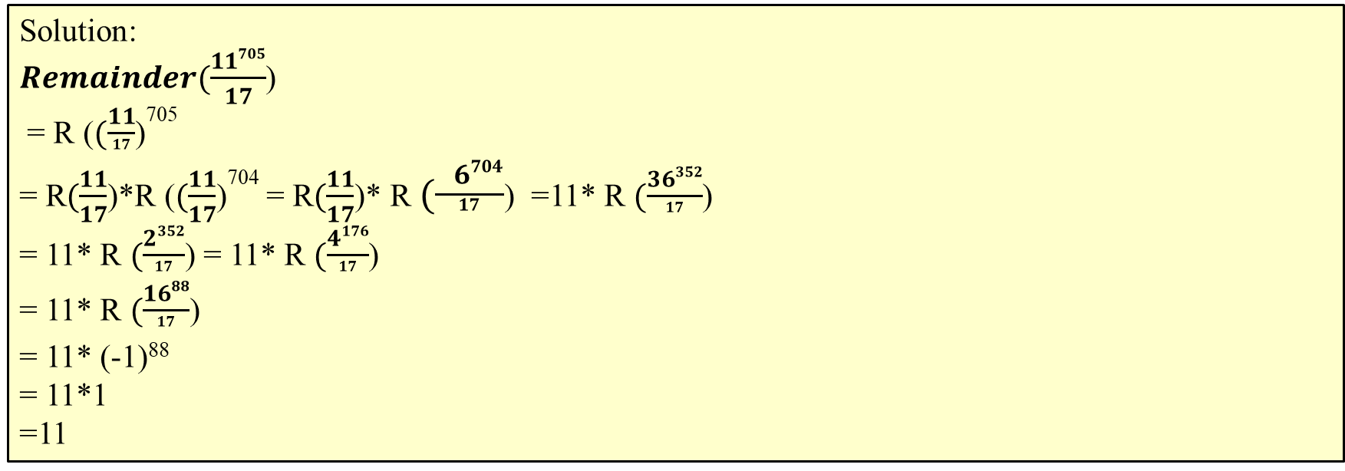
Remainder Properties
Examples: Find the remainder when 11⁷⁰⁵ is divided by 17..
Solution:
$Remainder(\frac{11705}{17}$)
= R ($(\frac{11}{17}$)⁷⁰⁵
= R$(\frac{11}{17}$)*R ($(\frac{11}{17}$)⁷⁰⁴ = R$(\frac{11}{17}$)* R $(\frac{ 6704}{17}$) =11* R $(\frac{36352}{17}$)
= 11* R $(\frac{2352}{17}$) = 11* R $(\frac{4176}{17}$)
= 11* R $(\frac{1688}{17}$)
= 11* (-1)⁸⁸
= 11*1
=11

Slide 8
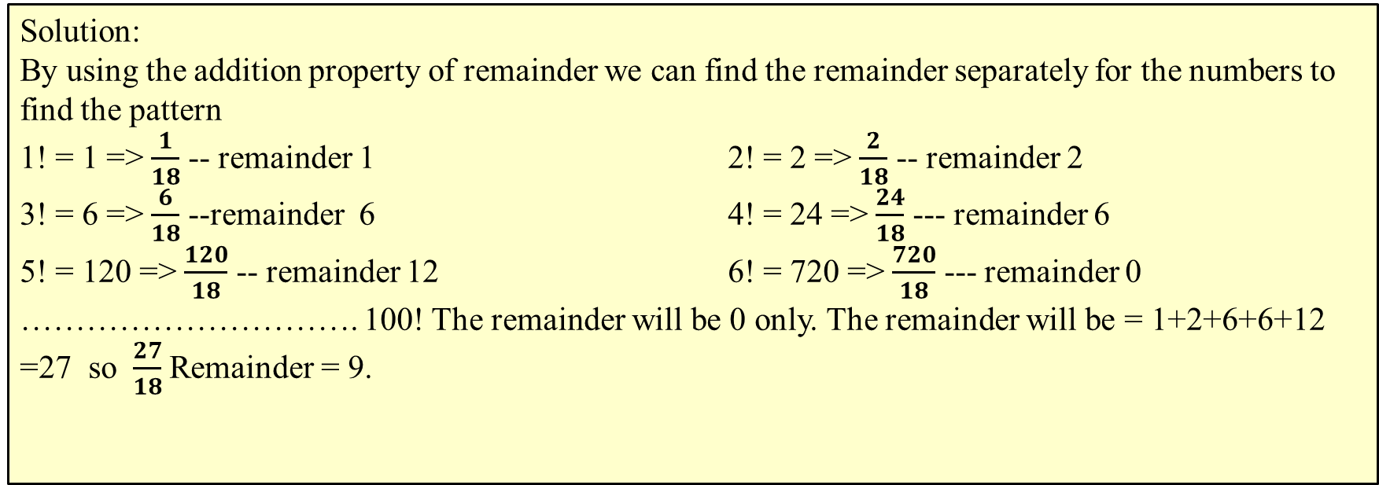
Remainder Properties
Examples: What is the remainder when 1! + 2! + 3! … 100! is divided by 18?
Solution:
By using the addition property of remainder we can find the remainder separately for the numbers to find the pattern
1! = 1 => $\frac{1}{18}$ -- remainder 1 2! = 2 => $\frac{2}{18}$ -- remainder 2
3! = 6 => $\frac{6}{18}$ --remainder 6 4! = 24 => $\frac{24}{18}$ --- remainder 6
5! = 120 => $\frac{120}{18}$ -- remainder 12 6! = 720 => $\frac{720}{18}$ --- remainder 0
…………………………. 100! The remainder will be 0 only. The remainder will be = 1+2+6+6+12
=27 so $\frac{27}{18}$ Remainder = 9.

Slide 9
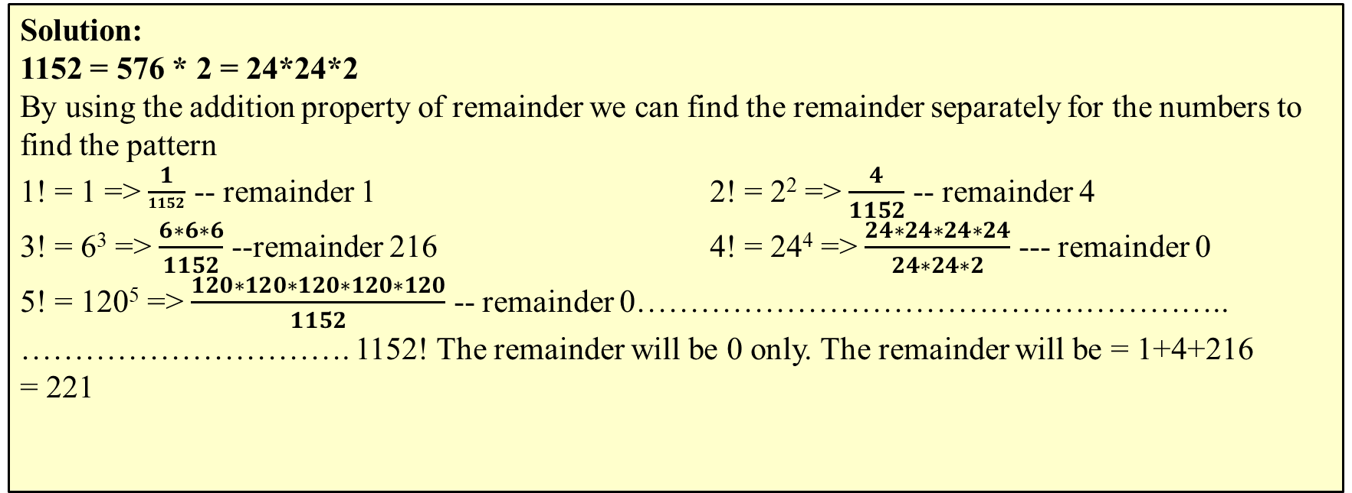
Remainder Properties
Examples: What is the remainder when the sum
(1!)¹ + (2!)² + (3!)³+..………………..+(1152!)¹¹⁵² is divided by 1152?
Solution:
1152 = 576 * 2 = 24*24*2
By using the addition property of remainder we can find the remainder separately for the numbers to find the pattern
1! = 1 => $\frac{1}{1152}$ -- remainder 1 2! = 2² => $\frac{4}{1152}$ -- remainder 4
3! = 6³ => $\frac{6∗6∗6}{1152}$ --remainder 216 4! = 24⁴ => $\frac{24∗24∗24∗24}{24∗24∗2}$ --- remainder 0
5! = 120⁵ => $\frac{120∗120∗120∗120∗120}{1152}$ -- remainder 0………………………………………………..
…………………………. 1152! The remainder will be 0 only. The remainder will be = 1+4+216 = 221

Slide 10
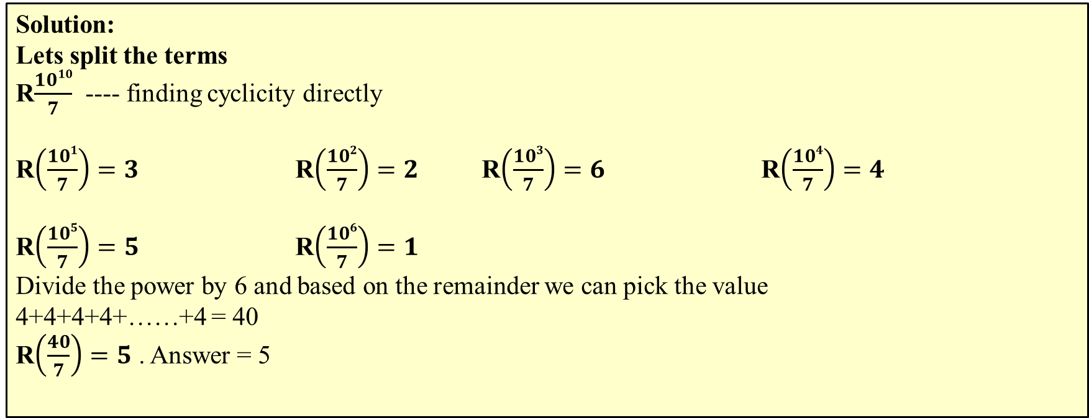
Remainder Properties
The remainder when 10¹⁰+10¹⁰⁰+10¹⁰⁰⁰+.... + 10¹⁰⁰⁰⁰⁰⁰⁰⁰⁰⁰ is divided by 7 is
Solution:
Lets split the terms
R$\frac{1010}{7}$ ---- finding cyclicity directly
R$\left(\frac{101}{7}\right)=3$ R$\left(\frac{102}{7}\right)=2$ R$\left(\frac{103}{7}\right)=6$ R$\left(\frac{104}{7}\right)=4$
R$\left(\frac{105}{7}\right)=5$ R$\left(\frac{106}{7}\right)=1$
Divide the power by 6 and based on the remainder we can pick the value
4+4+4+4+……+4 = 40
R$\left(\frac{40}{7}\right)=5$ . Answer = 5

Slide 11

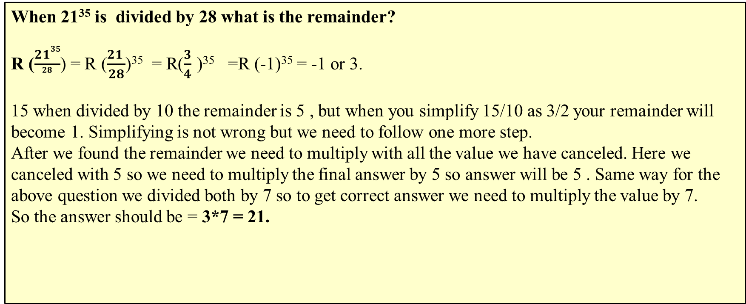
Remainder Properties
One commonly made mistake in Remainder Properties:
When 21³⁵ is divided by 28 what is the remainder?
R ($\frac{2135}{28}$) = R ($\frac{21 }{28}$)³⁵ = R($\frac{3}{4} \text{)}\text{35}$ =R (-1)³⁵ = -1 or 3.
15 when divided by 10 the remainder is 5 , but when you simplify 15/10 as 3/2 your remainder will become 1. Simplifying is not wrong but we need to follow one more step.
After we found the remainder we need to multiply with all the value we have canceled. Here we canceled with 5 so we need to multiply the final answer by 5 so answer will be 5 . Same way for the above question we divided both by 7 so to get correct answer we need to multiply the value by 7.
So the answer should be = 3*7 = 21.

Slide 12
Remainder Properties
What is the remainder when 2(8!)-21(6!) divides 14(7!) +14(13!)?
Solution:
We need to find out Rem [(14(7!) + 14(13!)) / (2(8!) – 21(6!)) ] Let us try and simplify the divisor 2(8!) – 21(6!) = 2*8*7! – 3*7*6! = 16*7! – 3*7! = 13*7!
Rem [(14(7!) + 14(13!)) / 13*7! ] = Rem [14(7!) / 13(7!)] + Rem [14(13!) / 13(7!)] = 7!*Rem[14/13] + 0 = 7!*1 = 7!

Slide 13
Remainder properties
Formulas Based Concepts for Remainder:
1. (a^{n} + b^{n}) is divisible by (a + b), when n is odd.
2. (a^{n} - b^{n}) is divisible by (a + b), when n is even.
3. (a^{n} - b^{n}) is always divisible by (a - b), for every n.
1. 3⁵⁰+5⁵⁰ when divided by 34 what is the remainder?
9²⁵+25²⁵ ---→ apply rule 1 , it will be divisible by 34 so remainder will be zero.
2. 33⁵⁶²⁰-12⁵⁶²⁰ will be divisible by 45 (i.e 33+12).
3. 57¹⁰⁹-32¹⁰⁹ will be divisible by 25 (i.e 57-32).

Slide 14
Section : Numerical Aptitude Topic : Number system Sub topic : Finding the last two digit.
To find the last two digit we are going to follow the same approach like we followed for finding the unit digit & Remainder properties.
Finding the Cyclicity & based on the pattern we can find the last two digits for any number with higher powers.

Slide 15
Finding last two digits
Cases:
If the unit digit is 0.
If the unit digit is 5.
If the unit digit is 1.
If the unit digit is 3, 7 ,9.
If the unit digit is 2, 4, 6, 8.

Slide 16
Finding last two digits
If the unit digit is 0.
Example:
What will be the last two digits in 1230¹²⁵ ?
Unit digit is 0.
If the unit digit is 0 it raised to any power greater than 1
Last two digit = 00

Slide 17
Finding last two digits
If the unit digit is 5.
It raised to any power unit digit will be 5.
To get the tens digit
If the power is even then last two digit will be 25.
If the power is odd check the tens digit
If the tens digit is odd last two digit will be 75
If the tens digit is even then last two digit will be 25.
Example:
2535¹²⁵ - last two digit 75.
2275¹²⁰ - last two digit 25.

Slide 18
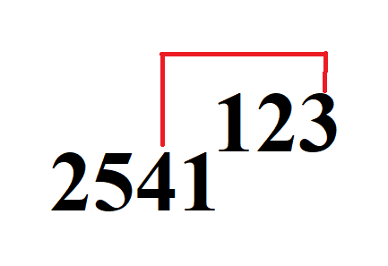
Finding last two digits
If the unit digit is 1.
It raised to any power unit digit will be 1.
To get the tens digit ,
Take the unit digit of the power and tens digit in the number. Find the product of the two and take the unit digit.
Example:
2541¹²³
- last two digit 21 .
2271¹²²⁵
- last two digit 51.

Slide 19
Finding last two digits
If the unit digit is 3,7,9
3
7
9
3^1 – 3
3^2 - 9
3^3 - 27
3^4 - 81
3^5 - 243
There are 4 cycles
3,9,7,1
7^1 – 7
7^2 - 49
7^3 - 343
7^4 - 2401
7^5 - …7
There are 4 cycles
7, 9 , 3, 1
9^1 – 9
9^2 - 81
9^3 - 729
9^4 - …1
There are 2 cycles
9,1,9,1

Slide 20
Finding last two digits
If the unit digit is 3,7,9
3
7
9
Find the last two digits of 33²⁸⁸.
(33⁴)⁷²
33*33 = 89
89*89 = 21
(21)⁷²
= 41
Find the last two digits of 87⁴⁷⁴.
(87⁴)¹¹⁸ * (87²)
87*87 = 69
69*69 = 61
(61)¹¹⁸ * (69)
= 81*69
= 89
Find the last two digits of 19²⁶⁶.
(19²)¹³³ = (361)¹³³
= 81

Slide 21
Finding last two digits
Group – 2,4,6,8
To find last two digits for the numbers ending with 2,4,6,8 we need to know about 24 & 76 pattern.
If the last two digit is 76 it raised to any power will give last two digit as 76.
If the last two digit is 24 then
If it raised to odd power will give 24 or if it is raised to even power will give 76.
So our task is to bring the last two digit as either 24 or 76 for the given numbers and find the last two digits.

Slide 22
Finding last two digits
If the unit digit is 2, 4 , 6 ,8
Find the last two digits of 64²³⁶.
64 = 2⁶
(2⁶)²³⁶
2¹⁴¹⁶
(2¹⁰)= 1024
(2¹⁰)¹⁴¹ * (2⁶)
(1024)¹⁴¹ * (64)
24 * 64
36
Find the last two digits of 54³⁸⁰.
54 = 2* 3³
(2* 3³)³⁸⁰
2³⁸⁰ * 3¹¹⁴⁰
(2¹⁰)³⁸ * (3⁴)²⁸⁵
(1024)³⁸ (81)²⁸⁵
76* 01
= 76
Find the last two digits of 78³⁷⁹.
78 = 2 * 39
(2* 39)³⁷⁹
2³⁷⁹ * 39³⁷⁹
(2¹⁰)³⁷ * (2⁹)* (39²)¹⁸⁹ * 39¹
(1024)³⁷ * 512 * (21)¹⁸⁹ * 39
= 24*12*81*39
= 92

Slide 23

Thank you

